Slide 1

University of Central Florida COP 3330 Object Oriented Programming

Slide 2
Agenda
Administrative
JavaFX

Slide 3
JavaFx

Slide 4
Java user interface history
First there was “awt” or Java’s abstract window toolkit
which was used for
Applets (embedded Java programs on webpages)
Applications
with this you could create buttons, checkboxes, text fields, etc… and make a program with a basic user interface
Next was Swing, Java’s updated gui (graphical user interface) library with more tools and an updated look and feel
Swing is still very popular and widely used
Java now has Oracle at the helm so Java is moving into a new and exciting direction

Slide 5
JavaFx
JavaFx has been around for a long time
2005: Sun acquired the technology when they bought out ‘See Beyond’
2007: first release of JavaFx, didn’t catch on
2009: Oracle acquired Java from Sun Microsystems
2010: Oracle announced the future direction for Java which included a completely redone JaxaFx as the centerpiece technology for building applications
2014: Java 8 released in and it is the first MAJOR Java release that includes JavaFx as an integral part of its core distribution

Slide 6
JavaFx
Oracle’s position regarding Swing and JavaFx is “JavaFX (is) replacing Swing as the new client UI library for Java”
Therefore developers need to start taking JavaFx seriously and start embracing it as the best way to build applications in Java

Slide 7
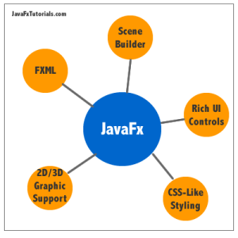
JavaFx

Slide 8
JavaFx Features
New and improved interface tools that way beyond your standard buttons, checkboxes, etc…
bar and pie charts and cool things you can find using JQuery like date-pickers, accordion panes, tabbed panes etc.. .
includes new media player and web rendering controls
New ‘language’ called FXML, like HTML is used only to define the interface of an application, keeping it completely separate from the code logic, same concept as C# and XAML by MicroSoft
Outstanding application called ‘Scene Builder’ which can be integrated into NetBeans and Eclipse to create and generate FXML documents using a drag-and-drop design interface (think Dreamweaver for HTML)

Slide 9
JavaFx
Powerful way to control the design of your application with CSS-like syntax and precision.
if you know any CSS you will easily be able to make the transition to styling JavaFx applications
Integrated library for graphics (both 2D and 3D) as well as animation tools that rival Flash, JQuery and CSS animations
Mobile platform development tools!!!!!!
Open-source project called JavaFx ports that helps bridge the path to mobile application development with JavaFx
Open-source! This is cool for 2 reasons:
It’s survival chances are greatly improved with a worldwide army of JavaFx developers contributing to the development and well-being of the technology
Others are quickly developing additional tools, plugins and UI controls that go beyond the offerings at Oracle

Slide 10
JavaFx Project in Netbeans
File→New Project
JavaFX application category, choose JavaFX FXML Application, click Next
Name the project, and click Finish
NetBeans IDE opens an FXML project that includes the code for a basic , includes three files:
FXMLExample.java: This file takes care of the standard Java code required for an FXML application
Sample.fxml: This is the FXML source file in which you define the user interface
SampleController.java: This is the controller file for handling the mouse and keyboard input
Enter fxml_example and click OK.

Slide 11
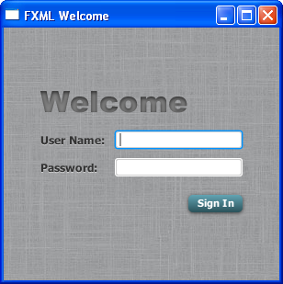


JavaFx
What can we create?
Responsive user interfaces
Animation and visual effects
Gradient color effects like in CSS

Slide 12
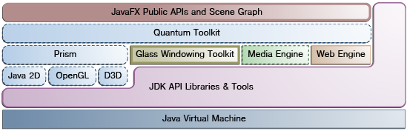
JavaFx Architecture
Above are the architectural components of the JavaFX platform.
Behind the JavaFX public APIs lies the engine that runs the JavaFX code
Comprises subcomponents
Prism: a JavaFX high performance graphics engine, called Prism
Glass: a small and efficient windowing system
Media engine
Web engine

Slide 13
JavaFx Architecture
Scene Graph
Java Public APIs for JavaFX Features
Graphics System
Glass Windowing Toolkit
Media and Images
Web Component
CSS
UI Controls
Layout
2-D and 3-D Transformations
Visual Effects

Slide 14
JavaFx Scene Graph
the starting point for constructing a JavaFX application
a hierarchical tree of nodes that represents all of the visual elements of the application's user interface
can handle input and can be rendered
a single element in a scene graph is called a node, each node has
an ID
style class
bounding volume
With the exception of the root node of a scene graph, each node in a scene graph has a single parent and zero or more children
It can also have the following:
Effects, such as blurs and shadows
Opacity
Transforms
Event handlers (such as mouse, key and input method)
An application-specific state

Slide 15
JavaFx Scene Graph
includes the graphics primitives, such as rectangles and text, in addition to having controls, layout containers, images and media
simplifies working with UIs, especially when rich UIs are used
animating various graphics in the scene graph can be accomplished quickly using the javafx.animation APIs
The javafx.scene API allows the creation and specification of several types of content, such as:
Nodes: Shapes (2-D and 3-D), images, media, embedded web browser, text, UI controls, charts, groups, and containers
State: Transforms (positioning and orientation of nodes), visual effects, and other visual state of the content
Effects: Simple objects that change the appearance of scene graph nodes, such as blurs, shadows, and color adjustment

Slide 16
JavaFx Java Public APIs for JavaFX Features
These Java APIs for JavaFX features:
Allow the use of powerful Java features, such as generics, annotations, multithreading, and Lamda Expressions
Make it easier for Web developers to use JavaFX from other JVM-based dynamic languages, such as Groovy and JavaScript
Allow Java developers to use other system languages, such as Groovy, for writing large or complex JavaFX applications
Allow the use of binding which includes support for the high performance lazy binding, binding expressions, bound sequence expressions, and partial bind reevaluation. Alternative languages (like Groovy) can use this binding library to introduce binding syntax similar to that of JavaFX Script
Extend the Java collections library to include observable lists and maps, which allow applications to wire user interfaces to data models, observe changes in those data models, and update the corresponding UI control accordingly

Slide 17
JavaFx Graphics System
supports both 2-D and 3-D scene graphs, two graphics accelerated pipelines are implemented on the JavaFX platform:
Prism
processes render jobs
can run on both hardware and software renderers, including 3-D
responsible for rasterization and rendering of JavaFX scenes
Quantum Toolkit
ties Prism and Glass Windowing Toolkit together and makes them available to the JavaFX layer above them in the stack
manages the threading rules related to rendering versus events handling

Slide 18
JavaFx Glass Windowing Toolkit
Its main responsibility is to provide native operating services, such as managing the windows, timers, and surfaces
It serves as the platform-dependent layer that connects the JavaFX platform to the native operating system
The Glass toolkit is also responsible for managing the event queue

Slide 19
JavaFx Threads
The system runs two or more of the following threads at any given time.
JavaFX application thread
this is the primary thread used by JavaFX application developers
any ”live” scene, which is a scene that is part of a window, must be accessed from this thread
enables developers to create complex scene graphs on a background thread while keeping animations on 'live' scenes smooth and fast
Prism render thread
this thread handles the rendering separately from the event dispatcher
allows frame N to be rendered while frame N +1 is being processed
this ability to perform concurrent processing is a big advantage, especially on modern systems that have multiple processors
Media thread
this thread runs in the background and synchronizes the latest frames through the scene graph by using the JavaFX application thread

Slide 20
JavaFx Pulse
A pulse is an event that indicates to the JavaFX scene graph that it is time to synchronize the state of the elements on the scene graph with Prism
A pulse is throttled at 60 frames per second (fps) maximum and is fired whenever animations are running on the scene graph
Even when animation is not running, a pulse is scheduled when something in the scene graph is changed
When a pulse is fired, the state of the elements on the scene graph is synchronized down to the rendering layer
Layout and CSS are also tied to pulse events, the system automatically performs a CSS and layout pass once per pulse to avoid performance degradation
The Glass Windowing Toolkit is responsible for executing the pulse events using high-resolution native timers to make the execution

Slide 21
JavaFx Media and Images
JavaFX media functionality is available through the javafx.scene.media APIs
JavaFX supports both visual and audio media
MP3
AIFF
WAV audio files
FLV video files
JavaFX media functionality is provided as three separate components
the Media object represents a media file
the MediaPlayer plays a media file
a MediaView is a node that displays the media

Slide 22
JavaFx Web Component
Web Engine component is based on WebKit, which is an open source web browser engine that supports
HTML5
CSS
JavaScript
DOM
SVG
It enables developers to implement the following features in their Java applications:
Render HTML content from local or remote URL
Support history and provide Back and Forward navigation
Reload the content
Apply effects to the web component
Edit the HTML content
Execute JavaScript commands
Handle events

Slide 23
JavaFx CSS
Cascading Style Sheets (CSS) provides the ability to apply customized styling to the UI of a JavaFX application without changing any of that application's source code
CSS can be applied to any node in the JavaFX scene graph and are applied to the nodes asynchronously
JavaFX CSS styles can also be easily assigned to the scene at runtime, allowing an application's appearance to dynamically change

Slide 24
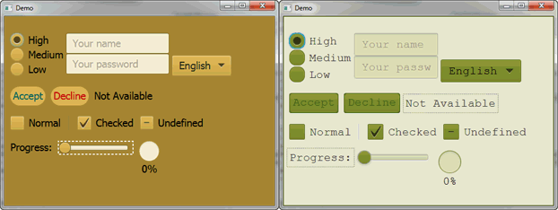
JavaFx CSS
JavaFX CSS is based on the W3C CSS version 2.1 specifications, with some additions from current work on version 3

